Slide 1





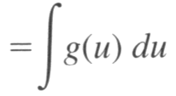



Section 4.6 Integration By Substitution (换元积分法)
Think of u=u(x) as a change of variable whose differential is
Then
G is an antiderivative of g

Slide 2
Integration By Substitution
Integration by substitution consists of the following general steps,
Choose a new variable u: a common choice is the innermost expression or "inside" term of a composition of functions.
Compute du=u’(x)dx.
Replace all terms in the original integrand with expressions involving u and du.
Evaluate the resulting new integral with respect to u. If you still can't evaluate the integral, you may need to try a different choice of u.
Replace each occurrence of u in the antiderivative with the corresponding expression in x

Slide 3
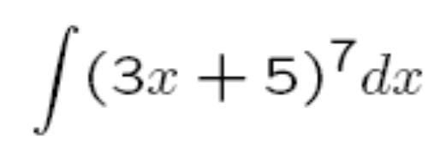

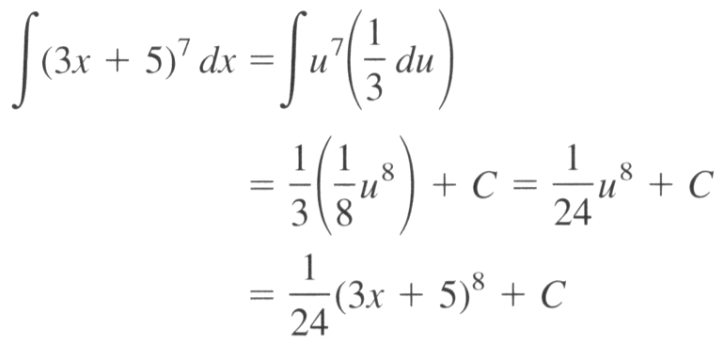
Section 4.6 Integration By Substitution (换元积分法)
How to do the following integral?
Answer
Let

Slide 4
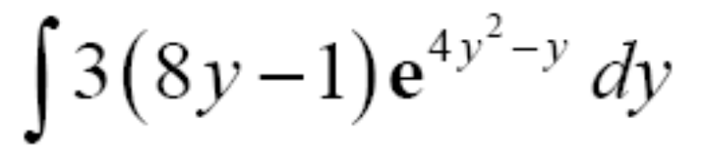


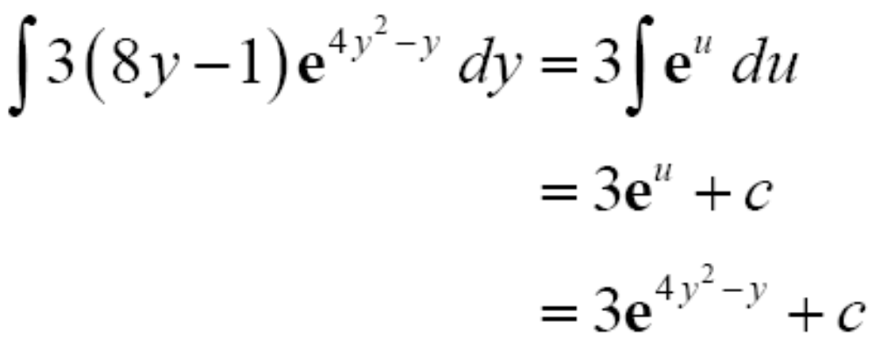
Example
Find
Solution:
You make the substitution
with
to obtain

Slide 5
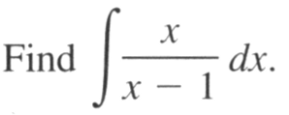



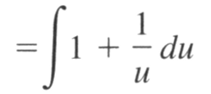

Example
Solution:
You make the substitution
with
to obtain

Slide 6

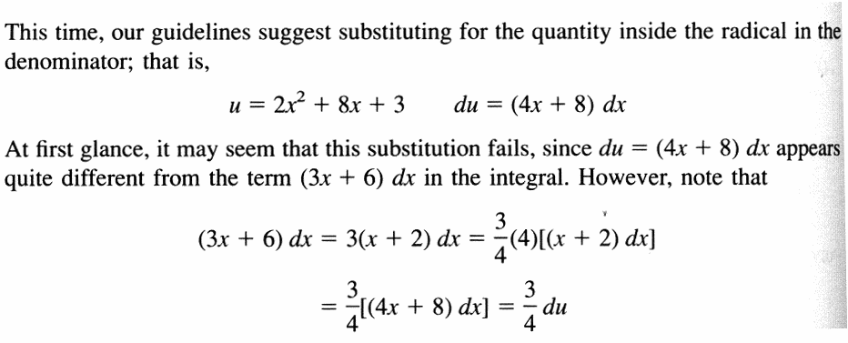
Example
Solution:
to be continued

Slide 7
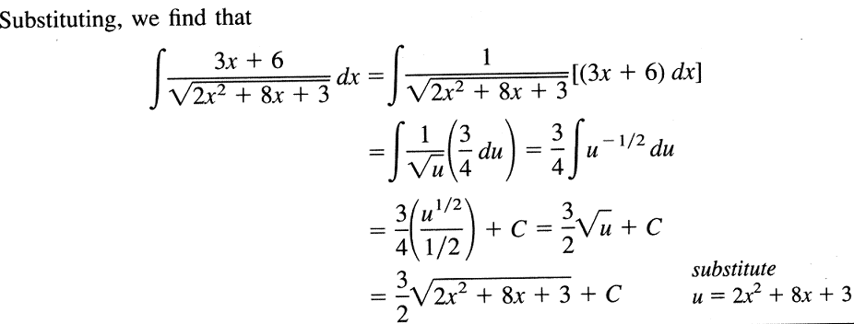

Slide 8
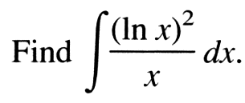


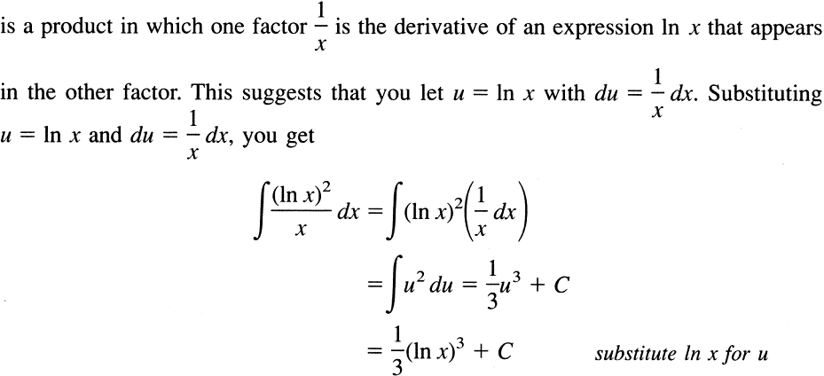
Example
Solution:

Slide 9
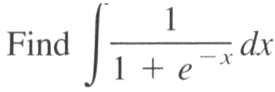
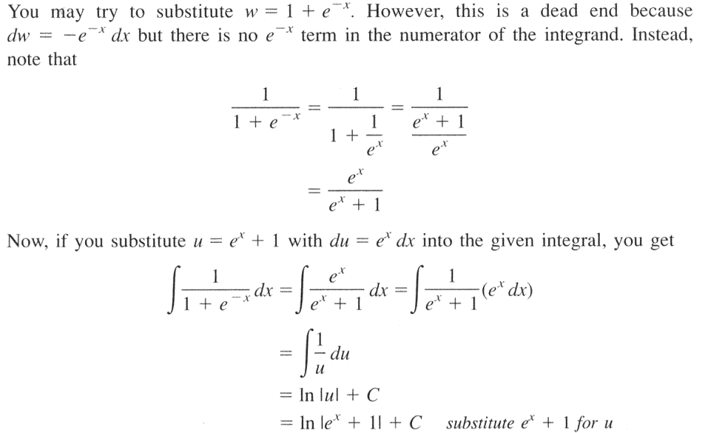
Example
Solution:

Slide 10
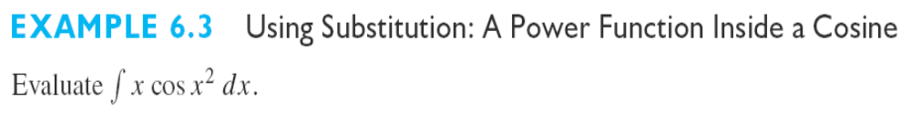
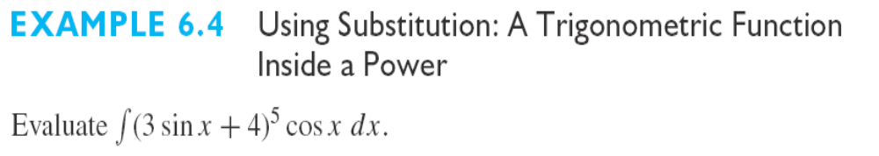



Slide 11
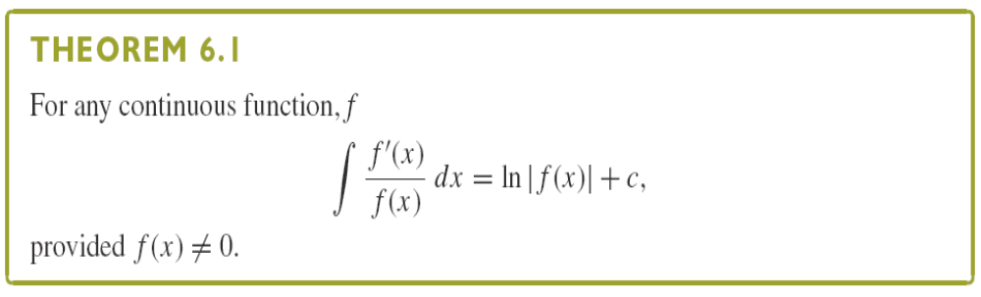

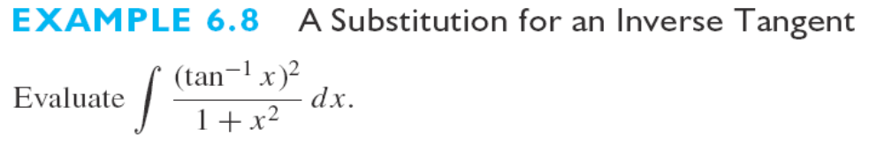

Slide 12


Substituting in a definite integral
定积分中的换元法

Slide 13

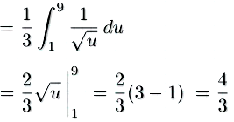

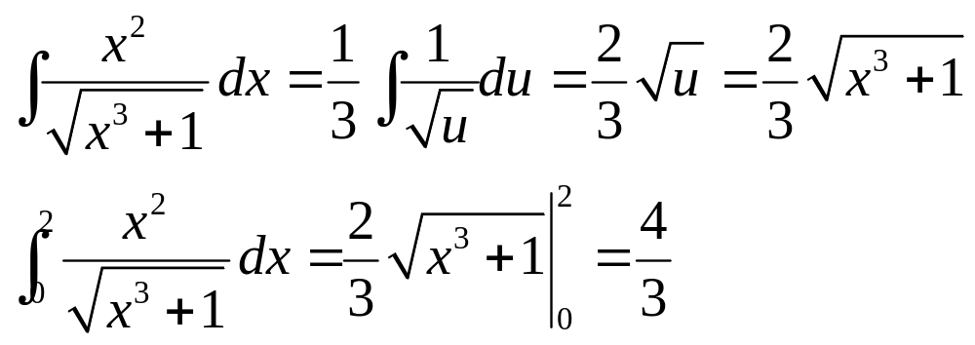
Example
Option 1.
Option 2.
+C

Slide 14

Substituting in a definite integral

Slide 15

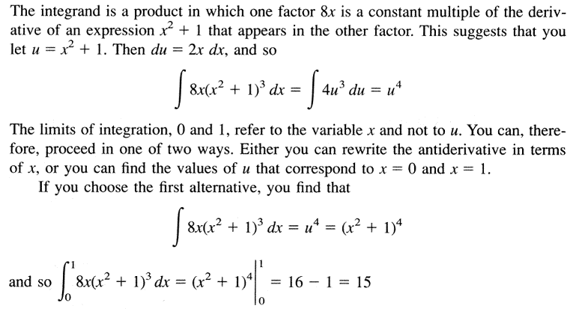
Example
to be continued

Slide 16
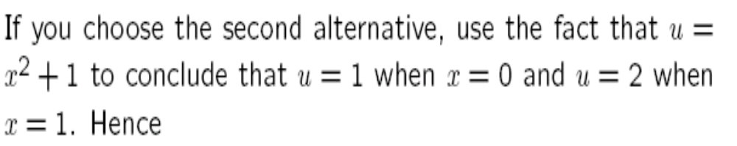


Slide 17
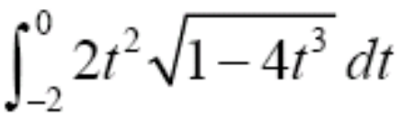


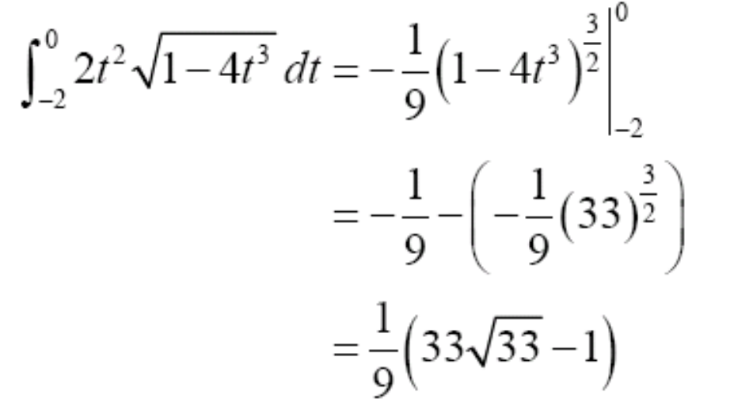
Example
Solution:
to be continued

Slide 18

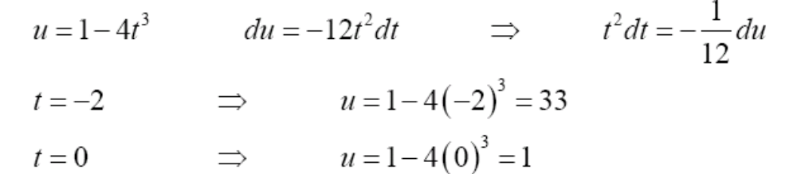
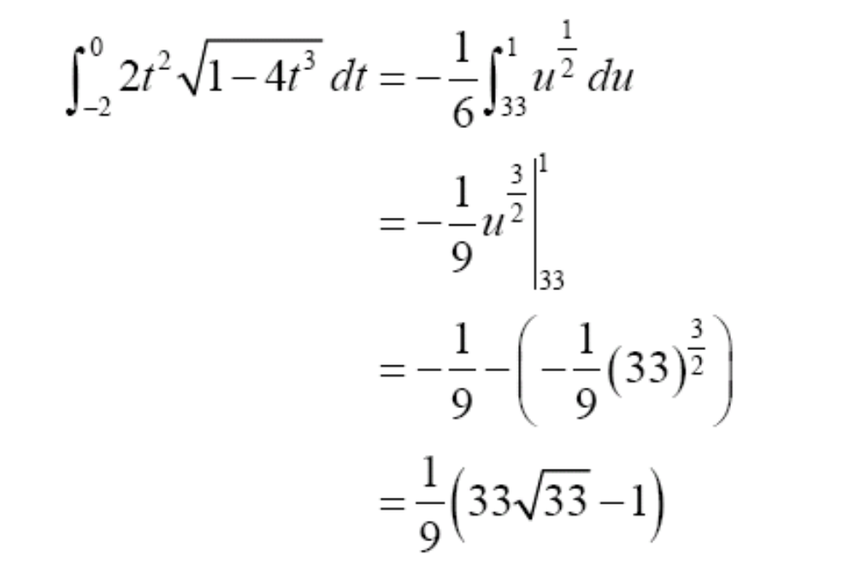

Slide 19
